Slide 1


ROBOT ARM INSTRUCTION
PART.3 – ARDUINO CODE
Prof. Wooyong Kim
Assistant. Dongsik Park
Department of Biomedical & Robotics Engineering,
Incheon National University
Summer, 2026

Slide 2
Table of Contents
  learning objectives – Forward Kinematics
  Forward Kinematics needs
  Direction of control practice
  Stepper motor
  Stepper motor action & Angle input action
  Gear ratio calculate
  Current angle check
  Forward Kinematics
  Inverse Kinematics – (Homework)

Slide 3
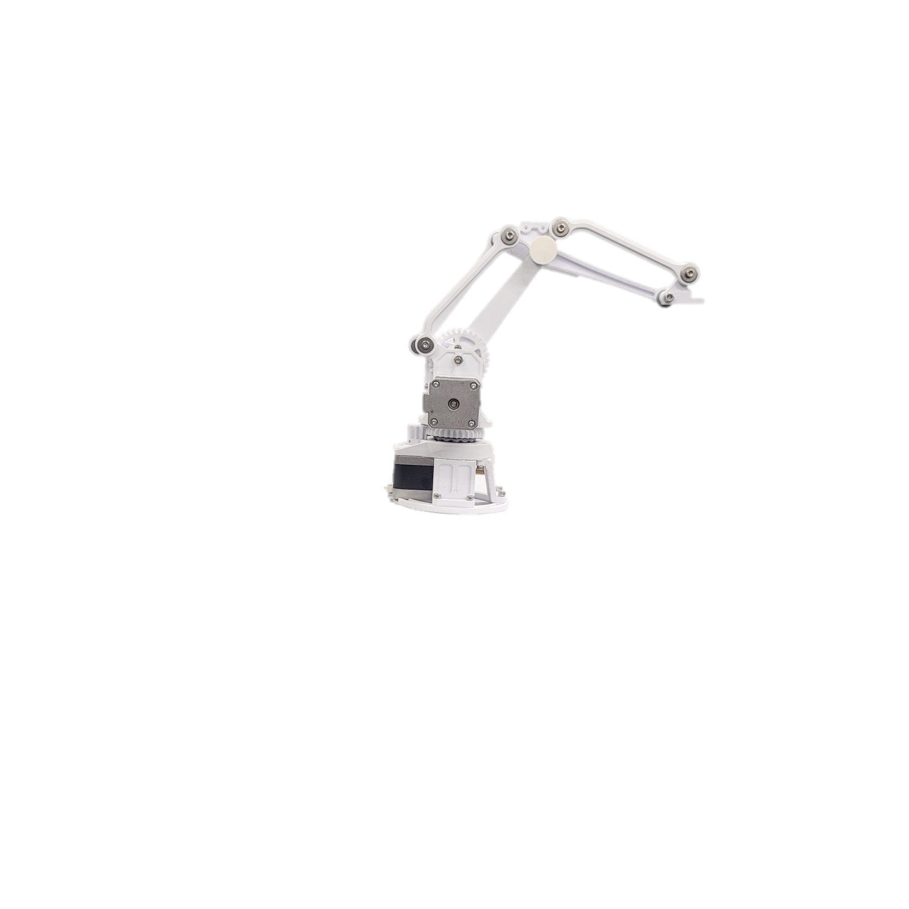



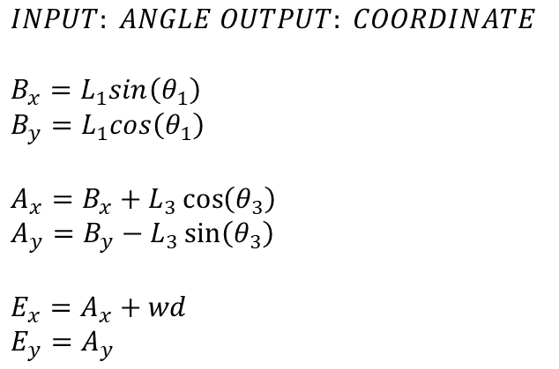





  learning objectives – Forward Kinematics
$$INPUT: ANGLE OUTPUT: COORDINATE$$
$$B_{x}=L_{1}sin\left(θ_{1}\right)$$
$$B_{y}=L_{1}cos\left(θ_{1}\right)$$
$$A_{x}=B_{x}+L_{3}\cos\left(θ_{3}\right)$$
$$A_{y}=B_{y}−L_{3}\sin\left(θ_{3}\right)$$
$$E_{x}=A_{x}+wd$$
$$E_{y}=A_{y}$$
$$θ_{3}$$
$$B_{x},B_{y}$$
$$wd$$
$$L_{3}$$
$$L_{1}$$
$$A_{x},A_{y}$$
$$E_{x},E_{y}$$
$$θ_{1}$$

Slide 4
  Forward Kinematics needs
$$INPUT: ANGLE OUTPUT: COORDINATE$$
$$B_{x}=L_{1}sin\left(θ_{1}\right)$$
$$B_{y}=L_{1}cos\left(θ_{1}\right)$$
$$A_{x}=B_{x}+L_{3}\cos\left(θ_{3}\right)$$
$$A_{y}=B_{y}−L_{3}\sin\left(θ_{3}\right)$$
$$E_{x}=A_{x}+wd$$
$$E_{y}=A_{y}$$
$$θ_{3}$$
$$B_{x},B_{y}$$
$$wd$$
$$L_{3}$$
$$L_{1}$$
$$A_{x},A_{y}$$
$$E_{x},E_{y}$$
$$θ_{1}$$
Trigonometric coordinate
Motor angle control
Current angle check
Gear ratio calculation

Slide 5
Direction of control practice
1. Manipulator should be operated using manual control code instead of backdrive
2. SDK for additional function queries
SDK
https://www.airspayce.com/mikem/arduino/AccelStepper/classAccelStepper.html

Slide 6
Stepper motor
VIDEO
https://www.youtube.com/watch?v=09Mpkjcr0bo&t=188s

Slide 7
Stepper motor action & angle input action
void loop()
{
rotationmovementinsert(3200,0,0)
anglemovementinset(360,0,0);//붐 30도 이동
}
void rotationmovementinsert(long base,long boom,long arm)
{
//0~3200사이 값을 입력 받아 스텝값으로 저장(마이크로 스텝은 16배인 3200)
positions[robot_position_base] = base;
positions[robot_position_arm] = arm;
positions[robot_position_boom] = boom;
steppers.moveTo(positions); //포지션 입력
steppers.runSpeedToPosition(); //각각 동작
}

Slide 8
Stepper motor action & angle input action
void anglemovementinset(double angle_base, double angle_boom, double angle_arm)
{
double instantbo, instantba, instantar;//지역 변수 선언
//베이스의 경우 감속기어가 없이 평기어만 부착되어있음에 원하는 각도에 따라 요구되는 스텝수 계산 수식
//1.스텝모터 1회전(360도)시 요구되는 스텝 = 200, (1스텝당 1.8도 이동)
//2.마이크로 스텝 설정시, 스텝 2,4,8,16배 증폭가능, 16배 증폭에 따라 스텝모터 1회전시 요구되는 스텝 = 200*16
//3.원하는 각도 입력시 상응하는 스텝수 계산식 = (angle/360)*200*16
instantba = (angle_base*microstep/360);
instantbo = (angle_base*microstep/360);
instantar = (angle_base*microstep/360);
//4.계산된 스텝값 인자로 입력, 이때, 스텝수는 long 형이고 현재는 세밀한 계산을 위해 형변환 입력
rotationmovementinsert((long)instantba, (long)instantbo, (long)instantar);
}

Slide 9
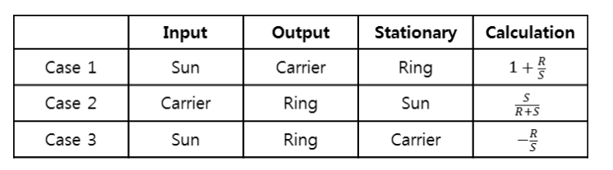
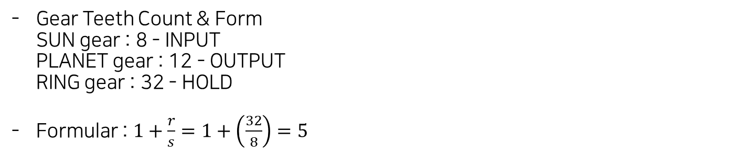
Gear ratio calculate
Gear Teeth Count & Form
SUN gear : 8 - INPUT
PLANET gear : 12 - OUTPUT
RING gear : 32 - HOLD
Formular : $1+\frac{r}{s}=1+\left(\frac{32}{8}\right)=5$

Slide 10
Gear ratio calculate
void anglemovementinset(double angle_base, double angle_boom, double angle_arm)
{
double instantbo, instantba, instantar;//지역 변수 선언
//1.스텝모터 1회전(360도)시 요구되는 스텝 = 200, (1스텝당 1.8도 이동)
//2.마이크로 스텝 설정시, 스텝 2,4,8,16배 증폭가능, 스텝모터 1회전시 스텝 = 200*16
//3.평기어 기어비 = 32/9(3.56)임에따라 평기어 1회전시 스텝 = 200*16*3.56
//4.추가적으로 5:1감속기어가 부착, 감속기어 1회전 스텝수 = 200*16*3.56*5
//5.원하는 감속기어 각도 입력시 이에 상응하는 스텝수 계산식 = (angle/360)*200*16*3.56*5
instantba = (angle_base*microstep/360);
instantbo = (planetarygear*angle_boom*smallgearstep*microstep*normgear/360);
instantar = (planetarygear*angle_arm*smallgearstep*microstep*normgear/360);
rotationmovementinsert((long)instantba, (long)instantbo, (long)instantar);
}

Slide 11
Current angle check
void currentpositionshower()//현재 각도를 출력하는 함수
{
long instantshower;//지역변수
instantshower = base.currentPosition();//프로그램 내부적으로 베이스 모터의 현재 스텝 값을 읽어옴
baseangle_current = (double)instantshower*360/(smallgearstep*microstep*normgear);//기어비 계산후 저장
Serial.print("\nangle current base:");
Serial.println(baseangle_current);//각도 출력
instantshower = boom.currentPosition();
boomangle_current = (double)instantshower*360/(smallgearstep*microstep*planetarygear*normgear);//감속기어 부착
Serial.print("angle current boom:");
Serial.println(boomangle_current);
instantshower = arm.currentPosition();
armangle_current = (double)instantshower*360/(smallgearstep*microstep*planetarygear*normgear);
Serial.print("angle current arm:");
Serial.println(armangle_current);
}

Slide 12
Forward Kinematics
$$INPUT: ANGLE OUTPUT: COORDINATE$$
$$B_{x}=L_{1}sin\left(θ_{1}\right)$$
$$B_{y}=L_{1}cos\left(θ_{1}\right)$$
$$A_{x}=B_{x}+L_{3}\cos\left(θ_{3}\right)$$
$$A_{y}=B_{y}−L_{3}\sin\left(θ_{3}\right)$$
$$E_{x}=A_{x}+wd$$
$$E_{y}=A_{y}$$
$$θ_{3}$$
$$B_{x},B_{y}$$
$$wd$$
$$L_{3}$$
$$L_{1}$$
$$A_{x},A_{y}$$
$$E_{x},E_{y}$$
$$θ_{1}$$

Slide 13
Forward Kinematics
void Foward_Kinematics_Action(double input_base,double input_boom,double input_arm)
{
Foward_Kinematics_Calculator(input_base,input_boom,input_arm);//입력 각도에 따른 좌표 계산
anglemovementinset(input_base,input_boom,input_arm);//각도 입력 및 이동
currentpositionshower();//현재 좌표 출력
}
void Foward_Kinematics_Calculator(double angle_base, double angle_boom, double angle_arm)
{
//double boom_L1 = 12.0;//boom의 길이
//double arm_L3 = 12.0;//arm의 길이
//double endeffectoroffset_wd = 3.0;//arm의 끝과 엔드이펙터 사이의 거리
angle_arm = radians(angle_arm);//입력 각도 도 -> 라디안 변환
angle_boom = radians(angle_boom);//입력 각도 도 -> 라디안 변환
double x_boom = boom_L1*sin(angle_boom);//붐의 끝부분 평면 좌표 x축 = sin(붐 각도)*붐 길이
double y_boom = boom_L1*cos(angle_boom)+y_offset;//붐의 끝부분 평면 좌표 y축 = cos(붐 각도)*붐 길이 + 본체 높이 오프셋 길이
double x_arm = x_boom+(arm_L3*cos(angle_arm));//암의 끝부분 평면 좌표 x축 = cos(암각도)*암 길이 + 붐 x좌표
double y_arm = y_boom-(arm_L3*sin(angle_arm));//암의 끝부분 평면 좌표 y축 = sin(암각도)*암 길이*-1 + 붐 y좌표()세타 3가 기준이라 반대로 이동
double x_end = x_arm+endeffectoroffset_wd;//최종 좌표 + 엔드이펙터 오프셋 거리
double y_end = y_arm;//최종 좌표
}

Slide 14
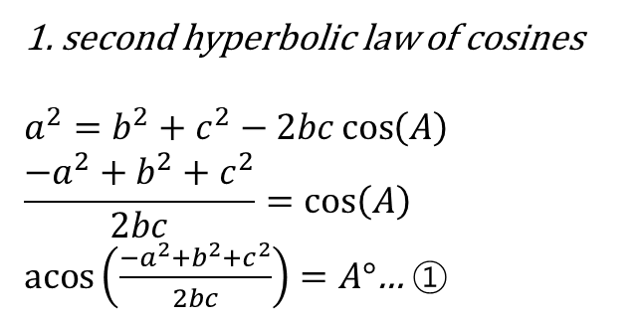
Inverse Kinematics – (Homework)
$$A$$
1. second hyperbolic law of cosines
$$a^{2}=b^{2}+c^{2}−2bc\cos\left(A\right)$$
$$\frac{{−a}^{2}+b^{2}+c^{2}}{2bc}=\cos\left(A\right)$$
$\operatorname{acos}\left(\frac{{−a}^{2}+b^{2}+c^{2}}{2bc}\right)=A°$… ①
$$c$$
$$b$$
$$a$$
2. Pythagoras' theorem
$a^{2}=b^{2}+c^{2}$ … ②
$$c$$
$$a$$
$$b$$

Slide 15


Inverse Kinematics – (Homework)
$$INPUT:COORDINATE OUTPUT:ANGLE$$
$$E_{x}=A_{x}+wd, E_{y}=A_{y}$$
$D=\sqrt{A_{x}^{2}+E_{y}^{2}}$ … ②
$$\operatorname{acos}\left(\frac{L_{1}^{2}+L_{3}^{2}−D^{2}}{2L_{1}L_{3}}\right)=θ_{21} …\text{①}$$
$$\operatorname{acos}\left(\frac{L_{1}^{2}+D^{2}−L_{3}^{2}}{2L_{1}D}\right)=θ_{α}…\text{①}$$
$$\operatorname{acos}\left(\frac{D^{2}+{\left(E_{x}−wd\right)}^{2}−E_{y}^{2}}{2D(E_{x}−wd)}\right)=θ_{β}…\text{①}$$
$$θ_{γ}=\left\{\begin{aligned}θ_{α}+θ_{β}, { E}_{y}≥0 \\ &θ_{α}−θ_{β},{ E}_{y}<0\end{aligned}\right.$$
$$θ_{1}=90−θ_{γ}$$
$$θ_{3}=180 −(θ_{21}+θ_{γ})$$
$$B_{x},B_{y}$$
$$θ_{γ}$$
$$θ_{3}$$
$$θ_{21}$$
$$L_{3}$$
$$wd$$
$$L_{1}$$
$$A_{x},A_{y}$$
$$E_{x},E_{y}$$
$$θ_{1}$$
$$θ_{γ}$$
$$D$$
$$θ_{3}$$
$$θ_{α}$$
$$θ_{β}$$

Slide 16
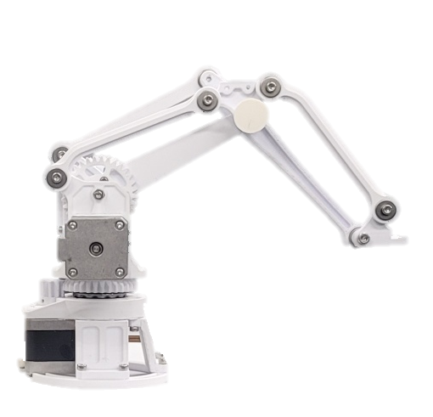



Inverse Kinematics – (Homework)
$$INPUT:COORDINATE OUTPUT:ANGLE$$
$$E_{x}=A_{x}+wd, E_{y}=A_{y}$$
$D=\sqrt{A_{x}^{2}+E_{y}^{2}}$ … ②
$$\operatorname{acos}\left(\frac{L_{1}^{2}+L_{3}^{2}−D^{2}}{2L_{1}L_{3}}\right)=θ_{21} …\text{①}$$
$$\operatorname{acos}\left(\frac{L_{1}^{2}+D^{2}−L_{3}^{2}}{2L_{1}D}\right)=θ_{α}…\text{①}$$
$$\operatorname{acos}\left(\frac{D^{2}+{\left(E_{x}−wd\right)}^{2}−E_{y}^{2}}{2D(E_{x}−wd)}\right)=θ_{β}…\text{①}$$
$$θ_{γ}=\left\{\begin{aligned}θ_{α}+θ_{β}, { E}_{y}≥0 \\ &θ_{α}−θ_{β},{ E}_{y}<0\end{aligned}\right.$$
$$θ_{1}=90−θ_{γ}$$
$$θ_{3}=180 −(θ_{21}+θ_{γ})$$
$$B_{x},B_{y}$$
$$θ_{γ}$$
$$θ_{3}$$
$$θ_{1}$$
$$θ_{21}$$
$$θ_{3}$$
$$L_{1}$$
$$L_{3}$$
$$θ_{α}$$
$$θ_{γ}$$
$$θ_{β}$$
$$D$$
$$wd$$
$$A_{x},A_{y}$$
$$E_{x},E_{y}$$

Slide 17
Thanks.

